Slide 1
e-Infochips Institute of Training Research and Academics Limited
LINUX DIRECTORY STRUCTURE
By: Aman Monika
Mukul

Slide 2
CONTENTS
INTRODUCTION
FILES
DIRECTORY
FILE SYSTEMS

Slide 3
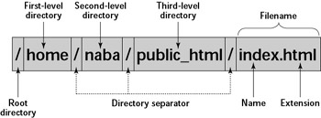
INTRODUCTION
If you want to make a file in Linux..from how you will start ?
First, you go to a place where you want make a file. Means you first define the location of file.
So to locate a file, you need more than just a file name, You also need information about the ”Directory hierarchy”
“ Important to know Linux directory structure”

Slide 4
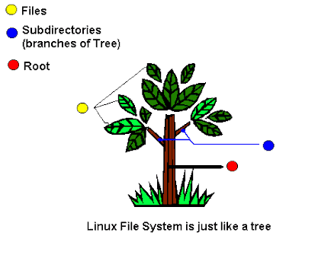
DIRECTORY TREE
A Directory structure is the way to represent the files to the user
All data in Linux is organized into data files
All files are organized into directories.
These directories are organized into a tree-like structure called the file-system

Slide 5
OVERVIEW OF DIRECTORY STRUCTURE
Filesystem Hierarchy Standard or FHS defines the directory structure and directory contents
All files and root directories appear under root directory /
They are located on virtual devices too.
It consists of :-
1). Files
2). Directories
3). Filesystems

Slide 6


FILES AND DIRECTORY
Directory is a file which stores filename and related information.It consists of files, subdirectories and links ( in windows directories are folders).
Whenever we refer to a file or directory, we can, in fact, use either type of path
a). Relative path
A file or directory location relative to where we currently are in the file system.
b). Absolute path
A file or directory location in relation to the root of the file system.

Slide 7
FILE TYPES
LINUX has different file types. They are :-
Regular files (-):- like excecutable files,images text,configuration etc.
Block special file (b):- data moves in large fixed-size blocks
Character special file (c) :- means data is transferred one character at a time
Directory file (d) :- contains a listing of files and directories
Symbolic Link file (l):- Links on any regular file
Pipe (p) :- A mechanism for interprocess communication which moves data in one direction
Socket (s):- Data can move bi-directionally.

Slide 8
FILE SYSTEM
The data is organised and can be easily located
The data can be easily retrieved at any later point in time
The integrity of data is preserved
It looks like an inverted tree structure
Start with root directory ,denoted by /

Slide 9
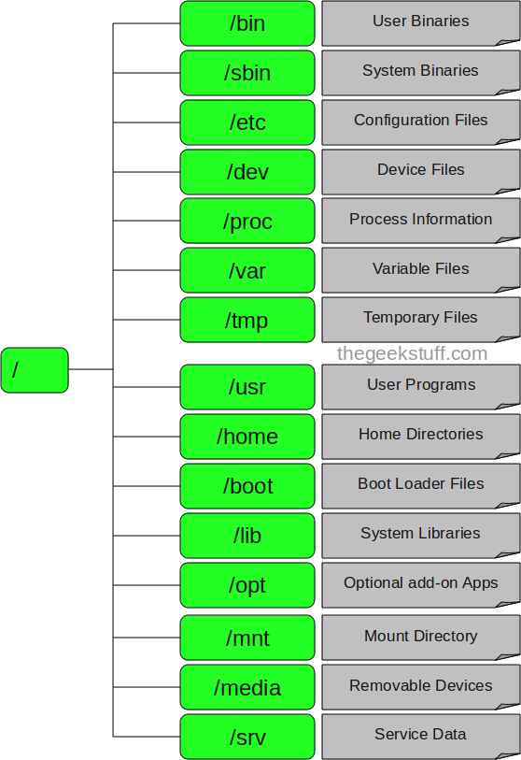
FILE SYSTEM STRUCTURE

Slide 10
1. / (Root) :
It can be refer to the top of the file structure.
Every single file and directory starts from the root directory
Only root user has the right to write under this directory
/root is root user’s home directory, which is not same as /

Slide 11
2. /bin :
Stands for binary
Need for system startup
Used by everyone in terminal Shells like bash, csh
No subdirectories in /bin
Basic commands for
Navigating file system
File management

Slide 12
3. /boot :
Contains Boot loader files
Kernel initrd(initial ram disk), vmlinux, grub files are located under /boot
Example: initrd.img-2.6.32-24-generic, vmlinuz-2.6.32-24-generic
/boot is static and unsharable directory
Contains everything except boost configuration files

Slide 13
4. /dev :
Stands for devices
It has location of device files, e.g., /dev/null.
These include terminal devices, usb, or any device attached to the system.
It is equivalent to a mashup of the device manager
A device can be read from and written to.
Ex:- ./dev/usb - USB device nodes
./dev/cdrom - CD-ROM drive

Slide 14
5. /etc :
Contains all system related configuration files.
Contains configuration files required by all programs.
This also contains startup and shutdown shell scripts used to start/stop individual programs.
Example: /etc/xml – configuration files for xml
/etc/hostname – contains the hostname of your machine
/etc/fstab – static information about filesystems

Slide 15
6. /home :
Users’ home directories, containing saved files, personal settings, etc.
Home directories for all users to store their personal files which start with “.”
example: /home/kishlay, /home/kv

Slide 16
7. /lib :
All essential libraries which are needed for system startup
Also in this directory are kernel modules
Libraries essential for the binaries in /bin/ and /sbin/.
Library filenames are either ld* or lib*.so.*
Example: ld-2.11.1.so, libncurses.so.5.7

Slide 17
8. /media :
Mount points for removable media such as CD-ROMs (appeared in FHS 2.3).
Temporary mount directory for removable devices.
Examples:- /media/cdrom for CD-ROM;
/media/floppy for floppy drives;
/media/cdrecorder for CD writer

Slide 18
9. /mnt :
Mounting is the process by which you make a filesystem available to the system
Mount point for temporarily mounted filesystems.
Temporary mount directory where sysadmins can mount filesystems.
Points for removable devices that have been mounted manually

Slide 19
10. /opt :
Optional application software packages.
Contains add-on applications from individual vendors.
Add-on applications should be installed under either /opt/ or /opt/ sub-directory.

Slide 20
11. /sbin :
Essential system binaries, e.g., fsck, init, route.
Only root can access
Just like /bin, /sbin also contains binary executables.
The linux commands located under this directory are used typically by
system administrator, for system maintenance purpose.
Example: iptables, reboot, fdisk, ifconfig, swapon

Slide 21
12. /srv :
Site-specific data served by this system, such as data and scripts for web
servers, data offered by FTP servers, and repositories for version control
systems.
srv stands for service.
Contains server specific services related data.
Example, /srv/cvs contains CVS related data.

Slide 22
13. /tmp :
Temporary files.
Often not preserved between system reboots, and may be severely
size restricted.
Directory that contains temporary files created by system and users.
Files under this directory are deleted when system is rebooted.

Slide 23
14. /usr :
It is shareable read-only user data; contains the majority of (multi-)user utilities and applications.
Contains binaries, libraries, documentation, and source-code for second level programs.
/usr/bin contains binary files for user programs. If you can’t find a user binary under /bin, look under /usr/bin. For example: at, awk, cc, less, scp
/usr/sbin contains binary files for system administrators. If you can’t find a system binary under /sbin, look under /usr/sbin.For example: atd, cron, sshd,useradd, userdel
/usr/local contains users programs that you install from source. For example,when you install apache from source, it goes under /usr/local/apache2
/usr/src holds the Linux kernel sources, header-files and documentation.

Slide 24
15. /proc :
The files are readable and will give you a picture of how the kernel sees your computer
Virtual filesystem providing process and kernel information as files. In Linux, corresponds to a procfs mount. Generally automatically generated and populated by the system, on the fly.
Contains information about system process.
This is a pseudo filesystem contains information about running process. For example: /proc/{pid} directory contains information about the process with that particular pid.
This is a virtual filesystem with text information about system resources. For example: /proc/uptime

Slide 25

Thank you

